Slide 1
MTN-027 Study Overview
Phase 1 Safety and Pharmacokinetics Study of MK-2048/Vicriviroc (MK-4176)/MK-2048A Intravaginal Rings
MTN-027 Study Specific Training

Slide 2
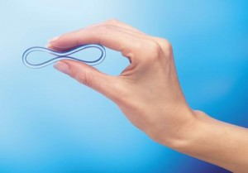

MTN-027 Background/Rationale
Intravaginal Rings (IVRs) may offer an ideal method of drug delivery for HIV prevention
  Discreet, coitally independent, offer continuous delivery of drug
  It is likely that products that can be applied less frequently may be more acceptable to users, resulting in higher user-adherence and may lead to increased effectiveness.

Slide 3
MTN-027 Background/Rationale
Combining ARV drugs with different mechanisms of action may increase the breadth of protection and limit the emergence of resistant HIV viral strains.
VCV(MK-4176):
CCR5-receptor antagonist
MK-2048:
HIV-1 integrase inhibitor
MK-2048A
Notes:
VCV is a CCR5-receptor antagonist that is potent against CCR5-tropic viruses, which are the predominantly transmitted HIV viral strains, and is active against viruses resistant to other drug classes. Development of resistance to VCV maleate (MK-7690) during Phase 3 trials was uncommon, thereby making it an attractive microbicide candidate. However, VCV is not active against viruses using co-receptors other than CCR5.
MK-2048 is an HIV-1 integrase inhibitor that is highly potent against both wild type HIV- 1 and raltegravir-resistant isolates.
The combination IVR is novel as it combines two different classes of ARV agents. The combination of two highly potent ARVs not currently being used for HIV-1 treatment may serve as an ideal HIV prevention combination.

Slide 4
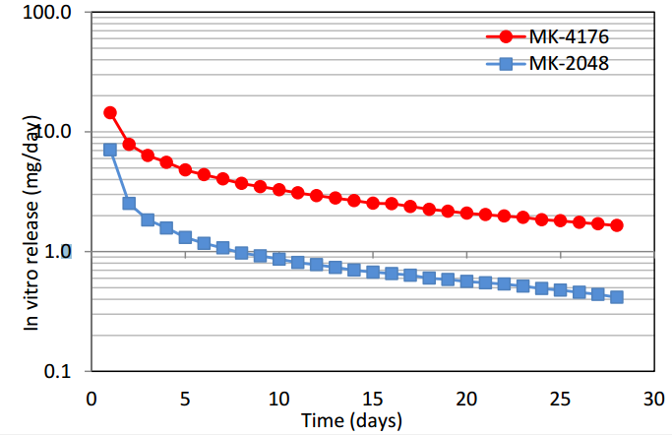
In vitro release of VCV (MK-4176) and MK-2048 from MK-2048A combination IVR
Notes:
An initial burst release of both compounds was observed during the first 1 to 2 days of incubation
Peak release approximately 14 and 7 mg/day for VCV (MK- 4176) and MK-2048, respectively.
Following this initial burst, drug release stabilized between days 5 to 28, with release rates ranging between 4.8 to 1.65 mg/day for VCV (MK-4176) and 1.3 to 0.415 mg/day for MK-2048.
Assuming a total vaginal fluid volume of 10 ml, the predicted fluid levels of VCV (MK-4176) and MK-2048 on day 28 would be approximately 300 µM and 90 µM respectively; concentrations many fold above the in vitro antiviral IC95 for each compound.

Slide 5
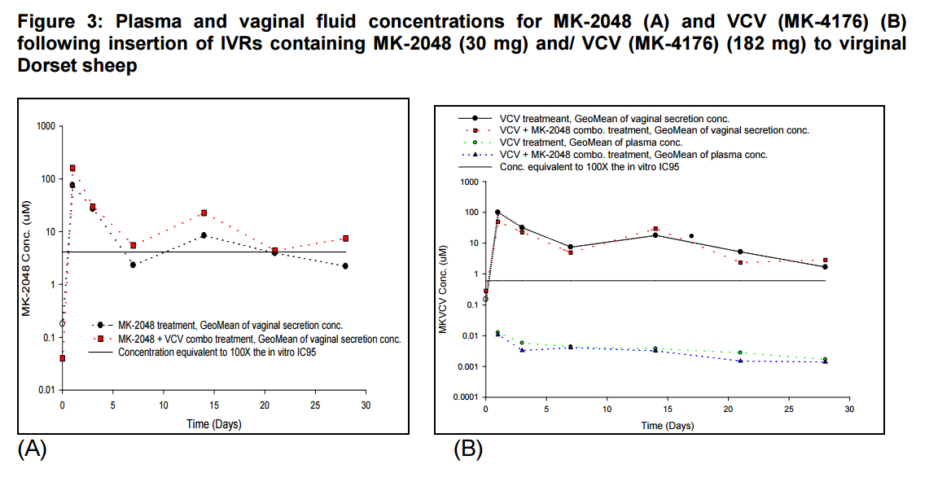
Non Clinical Studies of VCV (MK-4176) and MK-2048 Combination
Notes:
IVRs were generally well tolerated. The presence of the IVR was associated with mixed cell inflammation of the vaginal epithelial and sub-epithelial tissues and hypertrophy of the vaginal epithelium. Similar changes in animals that received the placebo IVR compared to those that received IVRs containing drug eliminates the drugs alone or in combination as the sole cause of the microscopic observations.
The maximal concentrations of MK-2048 and VCV in local vaginal secretions were achieved a day after ring insertion.
Pharmacokinetic analysis indicated that mean plasma concentration of VCV (MK-4176) were low (≤0.013 μM) and plasma levels of MK-2048 in plasma were below the lower limit of quantitation (LLOQ) (0.0005 to 0.001 µM) at all-time points.

Slide 6
Clinical Studies
MTN-027 IVRs have not yet been evaluated in humans
The pharmacokinetics, safety and tolerability of oral VCV maleate (MK-7690) have been evaluated in 2,122 subjects across Phase 1-3 clinical studies.
  Generally well tolerated, without identification of an exposure-related toxicity.
  Most common side effects: diarrhea, nausea, headache, upper respiratory infection, nasopharyngitis (infectious swelling/redness of the nose and throat), and fatigue.
  No clear difference in the rate of side effects among people who received vicriviroc compared with those who did not.
One Phase 1 clinical trial of MK-2048 in an oral formulation has been conducted (n=16).
  Only one adverse event was reported by more than one subject: mild headache.
Currently, no risk information is available for these two drugs combined.
Notes:
The following side effects have been associated with the use of vicriviroc in patients being treated for HIV. These side effects may or may not be associated with the use of vicriviroc when the drug is placed into a vaginal ring and worn by HIV-negative women: • Hepatocellular events (Liver problems) • Ischemic cardiovascular events (Heart problems, such as a heart attack) • Dyslipidemias (High blood lipid or cholesterol levels) • Herpes simplex virus (HSV) infections • Upper respiratory infections • Seizures • Malignancies (Cancerous tumor)

Slide 7
MTN-027 & MTN-028
The safety/PK and acceptability of VCV (MK-4176) and MK-2028 alone and in combination (MK-2048A) will be evaluated in MTN-027
Data from MTN-027 will be paired with MTN-028, which evaluates safety and pharmacokinetics of MK-2048A (combination IVR) at two doses:
  182 mg VCV (MK-4176)/ 30 mg MK-2048 (MTN-027 dose)
  91 mg of VCV (MK-4176)/10 mg of MK-2048 (low dose)
Both studies will contribute information to further optimize the drug release profiles of a combination IVR for use in future studies, including the potential development of a combination antiretroviral/contraceptive ring.

Slide 8
MTN-027 – Study Objectives
Primary Objectives:
  Assess and compare the safety of IVRs containing vicriviroc (MK-4176), MK-2048, or vicriviroc (MK-4176) + MK-2048 combined, when used continuously for 28 days, as compared with the placebo IVR
  Examine local and systemic pharmacokinetics of vicriviroc (MK-4176) and MK-2048 in vaginal fluid, plasma and cervical tissue during and after 28 days of continuous IVR use.

Slide 9
MTN-027 – Study Objectives
Secondary Objectives:
  Evaluate the acceptability of the study IVR
  Evaluate the adherence to the study IVR
Exploratory Objectives:
  Evaluate the HIV inhibitory activity of cervical tissue
  Assess drug levels in rectal fluid
  Describe the genital microenvironment
  Evaluate the potential relationship between participant self-report of adherence, vicriviroc (MK-4176) and MK-2048 remnant content in returned IVRs, and PK levels

Slide 10
MTN-027 – Study Design/Population
Sample Size: Approximately 48 women
Study Population: Healthy, HIV-uninfected, sexually abstinent women between ages 18-45
Study Design: Multi-site, single-blind, four-arm, randomized, placebo-controlled trial
Study Sites: UAB, Pittsburgh
Study Duration: Approximately 5 weeks per participant, with approximately 6-9 months for planned accrual at each site

Slide 11
MTN-027 – Study Products/Regimen
Study Products:
  182 mg Vicriviroc (MK-4176) IVR
  30 mg MK-2048 IVR
  MK-2048A (182 mg Vicriviroc [MK-4176] + 30 mg MK-2048) IVR
  Placebo IVR
Study Regimen:
  Randomized to study IVR assignment in a 1:1:1:1 ratio
  Participants will insert one IVR to be used for a period of approximately 28 days, followed by approximately 7 days of no study product use.

Slide 12
Inclusion Criteria
Born female
Age 18-45, inclusive
Able/willing to provide IC
Adequate locator
HIV uninfected
In general good health
Willing to abstain from receptive sexual activity for 5 days prior to Enrollment and duration of study
Using and intends to continue using an effective method of contraception
If ≥ 21 years old, satisfactory Pap result (Grade 0 or Grade 1 or higher with no treatment) w/in past 3 years
Agrees not to participate in other studies involving drugs, medical devices, or vaginal products
Regular menstrual cycles with at least 21 days between menses (N/A if using progestin-only method or continuous combination oral contraceptive pills)
Willing to refrain from inserting non-study vaginal products or objects into the vagina for the 5 days prior to Enrollment and duration of study
Notes:
Receptive sexual activity: includes penile-vaginal intercourse, anal intercourse, receptive oral intercourse, finger stimulation, and the use of sex toys
Effective contraception: hormonal methods (except contraceptive IVRs), intrauterine device (IUD) inserted at least 28 days prior to enrollment, engages in sex exclusively with women, sterilized (self or partner), and/or sexually abstinent for the past 90 days
Non vaginal study products: including, but not limited to, spermicides, female condoms, diaphragms, contraceptive IVRs, vaginal medications, menstrual cups, cervical caps (or any other vaginal barrier method), douches, lubricants, sex toys (vibrators, dildos, etc.)

Slide 13
Exclusion Criteria
Known adverse reactions to any component of study product
IVDU w/in 12 months
PEP or PrEP w/in 6 months
Use/anticipated use of CYP3A inducer(s) and/or inhibitor(s)
Use/anticipated use of female-to-male transition therapy
Chronic/recurrent vaginal candidiasis
Syphilis, GC or CT w/in 6 months
Last pregnancy outcome within 90 days
Currently breastfeeding
Intends pregnancy in next 3 months
Has had a hysterectomy
Plans to relocate in next 3 months
Known HIV positive partner
Participation in other study involving drugs, medical devices, or vaginal products, w/in 60 days
Uncontrolled/chronic condition (IoR/designee)

Slide 14
Exclusion Criteria (Cont)
Abnormal Labs at Screening:
≥ Grade 1 ALT/AST
Creatinine clearance < 60mL/min
≥ Grade 1 hemoglobin
≥ Grade 1 platelet count
≥ Grade 2 WBCs
Hepatitis B positive
Hepatitis C positive
International normalized ratio (INR) > 1.5 x the site ULN
Currently Pregnant
Symptomatic/untreated UTI/RTI/STI
Ongoing ≥ Grade 1 pelvic finding
Severe pelvic relaxation
Any other condition per IoR/designee discretion
Notes:
Pelvic relaxation: such that either the vaginal walls or the uterine cervix descend beyond the vaginal introitus with valsalva maneuver or has pelvic anatomy that compromises the ability to adequately assess vaginal safety
IoR Discretion: that would preclude informed consent, make study participation unsafe, complicate interpretation of study outcome data, or otherwise interfere with achieving the study objectives
Note: Otherwise eligible participants with an exclusionary test result (other than HIV, HBV or HCV) can be re-tested during the screening process. If a participant is re-tested and a non-exclusionary result is documented within 45 days of providing informed consent for screening, the participant may be enrolled.
Note: If diagnosed with Gonorrhea, chlamydia and/or syphilis diagnosis in the 6 months prior to Enrollment; this is exclusionary (treating and resolution of symptoms does not make them eligible).

Slide 15
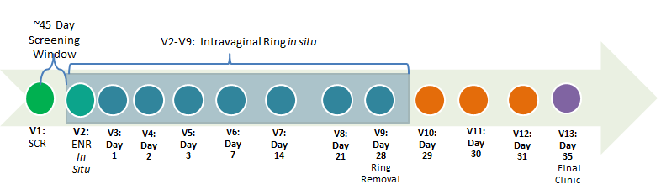
MTN-027 – Visit Schedule

